Slide 1
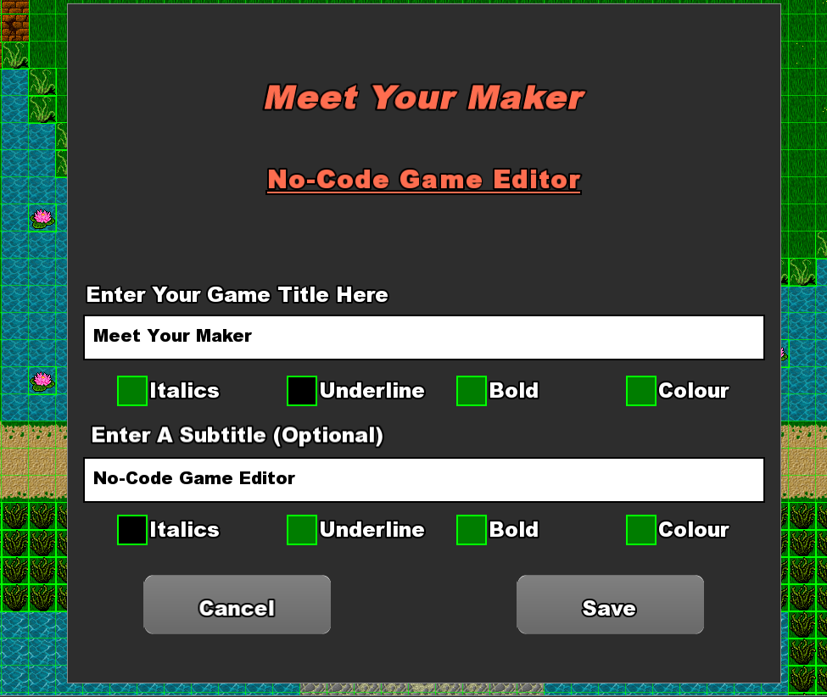
 | Patrick Donnelly, 49 Melitta Park, Kildare Town, Co. Kildare, R51 YX43. Website: https://patrickdonnelly.github.io Email: PatrickDonnelly3759@gmail.com Phone: +353 85 206 0205
Research Question:
"To what extent does a No-Code game editor implemented in C++ and SFML empower users with no programming experience to create complex games, and how does it compare to traditional game development processes in terms of usability, accessibility, and flexibility?
The idea was to research and implement a system that would allow a user to generate a game without any prior skillset in a technical area.
This would be achieved through intuitive User Interface. A visually simple Interface that would represent complex pre-programmed components, that could be utilized by the user to build a Game World.
Overview:
"Meet Your Maker" is a No-Code Game Editor that aims to introduce non-technical users to the process of Game Design and Development, through its simple user interface and pre-programmed game components.
A complex Editor that simplifies the complexity on the user’s end. The editor features a range of components created using C++ and SFML, that accommodates user designed game layouts, testing and playthroughs.
The user can save their build data using YAML throughout the creation process and load their game for further editing at a later time.
Key Technologies :
C++ (Technical Aspects and Functionality)
YAML (Data Storage - Reading and Writing)
SFML (Rendering, User Interface)
Progress to Date:
So far I have managed to create a No-Code Game Editor that allows the user to build, save and load their games without writing a single line of code. This is achieved through a friendly user interface and pre-programmed game components and entities that the user can click on in the UI View and place onto a grid into the Game View.
World Building Game Saving Game Loading | Built in Text Editor Dynamic Loading QoL Features
Further Development:
I have a lot of concepts I would like to build on in relation to my No-Code Game Editor, some of which are implemented to a certain degree already, albeit still a work in progress. I think with further development this No-Code Game Editor could be a robust piece of software that could be used to showcase Game Development courses and to encourage Novice programmers into the field. Aside from that I think it could also be a fun piece of software for those who enjoy level creation and simulation game.
For more information feel free to check out my website over on SETU’s Industry Showcase Website: https://showcase.itcarlow.ie/C00236160

Slide 2
 | Patrick Donnelly, 49 Melitta Park, Kildare Town, Co. Kildare, R51 YX43. Website: https://patrickdonnelly.github.io Email: PatrickDonnelly3759@gmail.com Phone: +353 85 206 0205
Research Question:
"To what extent does a No-Code game editor implemented in C++ and SFML empower users with no programming experience to create complex games, and how does it compare to traditional game development processes in terms of usability, accessibility, and flexibility?
The idea was to research and implement a system that would allow a user to generate a game without any prior skillset in a technical area.
This would be achieved through intuitive User Interface. A visually simple Interface that would represent complex pre-programmed components, that could be utilized by the user to build a Game World.
Overview:
"Meet Your Maker" is a No-Code Game Editor that aims to introduce non-technical users to the process of Game Design and Development, through its simple user interface and pre-programmed game components.
A complex Editor that simplifies the complexity on the user’s end. The editor features a range of components created using C++ and SFML, that accommodates user designed game layouts, testing and playthroughs.
The user can save their build data using YAML throughout the creation process and load their game for further editing at a later time.
Key Technologies :
C++ (Technical Aspects and Functionality)
YAML (Data Storage - Reading and Writing)
SFML (Rendering, User Interface)
Progress to Date:
So far I have managed to create a No-Code Game Editor that allows the user to build, save and load their games without writing a single line of code. This is achieved through a friendly user interface and pre-programmed game components and entities that the user can click on in the UI View and place onto a grid into the Game View.
World Building Game Saving Game Loading | Built in Text Editor Dynamic Loading QoL Features
Further Development:
I have a lot of concepts I would like to build on in relation to my No-Code Game Editor, some of which are implemented to a certain degree already, albeit still a work in progress. I think with further development this No-Code Game Editor could be a robust piece of software that could be used to showcase Game Development courses and to encourage Novice programmers into the field. Aside from that I think it could also be a fun piece of software for those who enjoy level creation and simulation game.
For more information feel free to check out my website over on SETU’s Industry Showcase Website: https://showcase.itcarlow.ie/C00236160

